Slide 1
Air Quality Index (AQI) Prediction Using
Machine Learning
By Gopalakrishnan Kumar, MTech IIT-Bombay,
Math AI Trainer, Outlier AI , Freelance Data Science Consultant
LinkedIn: Profile Link : https://www.linkedin.com/in/gopalakrishnankumar-a73301110/
Github:https://www.github.com/Gopalakrishnan-Kumar/
Kaggle URL- https://www.kaggle.com/gopalkk2

Slide 2
Google Colab URL
https://colab.research.google.com/drive/1swbvlMEph1XHCpRcTpOyvM70DYQCQ5ep?usp=sharing

Slide 3
Introduction
Air pollution is a critical environmental and public health issue globally. The Air Quality Index (AQI) is a key indicator used to communicate how polluted the air is and the health risks associated with it. Accurately predicting AQI helps authorities issue timely health advisories and take preventive action. In this project, we use machine learning techniques to build a model that can predict AQI based on the concentrations of major air pollutants.

Slide 4
Objectives
Use sensor data to predict AQI levels
Understand which pollutants most affect AQI
Evaluate model performance using real-world metrics
Visualize and interpret predictions and pollutant importance

Slide 5
Dataset Description
A synthetic dataset with 200 rows was generated, simulating real-world air quality monitoring data. It includes:
Feature | Description
PM2.5 | Fine particulate matter (≤2.5 μm)
PM10 | Particulate matter (≤10 μm)
NO₂ | Nitrogen Dioxide (NO₂) in µg/m³
SO₂ | Sulfur Dioxide (SO₂) in µg/m³
CO | Carbon Monoxide (CO) in mg/m³
O₃ | Ozone (O₃) in µg/m³
AQI | Air Quality Index (target variable)

Slide 6
Tools & Libraries
Language: Python
Libraries: pandas, scikit-learn, seaborn, matplotlib, numpy
Model Used: RandomForestRegressor (from Scikit-Learn)

Slide 7
Methodology
Data Generation & Preprocessing
Created synthetic values for 6 air pollutants
Calculated AQI using a weighted index formula
Split into training (80%) and test (20%) sets
Model Training
Used Random Forest Regressor to learn the relationship
between pollutants and AQI
Fitted model to training data and predicted AQI on the test set
Evaluation Metrics
RMSE (Root Mean Squared Error): Measures prediction error
R² Score (Coefficient of Determination): Indicates model fit

Slide 8
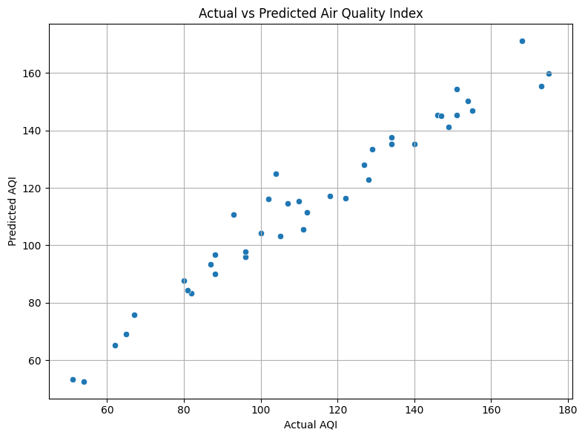
Data Visualization

Slide 9
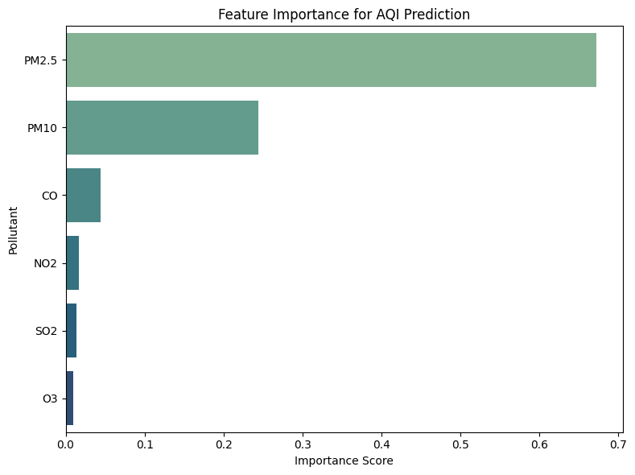
Data Visualization

Slide 10
Results
✅ Evaluation Metrics:
RMSE: Low error value indicating good prediction accuracy
R² Score: High score (>0.90), indicating strong correlation between actual and predicted AQI
📈 Visualization 1: Actual vs Predicted AQI
Points lie close to the diagonal, showing the model’s reliability
No major bias or underfitting
📌 Visualization 2: Feature Importance
PM2.5 and PM10 had the highest importance, indicating strong impact on AQI
Followed by NO₂ and CO

Slide 11
Insights
Fine particles (PM2.5) are the most significant predictor of poor air quality
Random Forest handles complex pollutant interactions well without overfitting
AQI forecasting can help pre-empt health risks in polluted areas

Slide 12
Recommendations
Install more PM2.5/PM10 sensors in urban centers
Use AQI prediction in health alert systems and weather dashboards
Improve models using real-world datasets from CPCB, OpenAQ, or NASA

Slide 13
Conclusion
This project demonstrates the use of machine learning to accurately predict AQI from environmental pollutant data. Such models can enhance early warning systems, support policymaking, and increase environmental awareness through accurate, data-driven insights.

